Slide 1

RDF Data Model
These slides are taken from Semantic Web Lectures of Prof. Dr. Soren Auer on
https://slidewiki.org/deck/584-14/semantic-data-web-lecture/slide/5407-6/589-12:3;5407-6:4/view?language=en_GB

Slide 2
References
W3c Recommendation: https://www.w3.org/TR/rdf11-concepts/
RDF Semantics https://www.w3.org/TR/rdf11-mt/
RDF Turtle https://www.w3.org/TR/turtle/

Slide 3
How do you encode the piece of knowledge:
"The theory of relativity was discovered by Albert Einstein."
<theory>
<name>Theory of Relativity</name>
<discoverer>Albert Einstein</discoverer>
</theory>

Slide 4
The other way
<person>
<name>Albert Einstein</name>
<discovered>Theory of Relativity</discovered>
</person>

Slide 5
The other way
<person name="Albert Einstein">
<discovered>Theory of Relativity</discovered>
</person>

Slide 6
XML is not sufficient
There is no unique way (in XML) to represent knowledge.
Information represented in such ways is not easy to integrate. (Why?)
RDF helps to solve this problem.

Slide 7
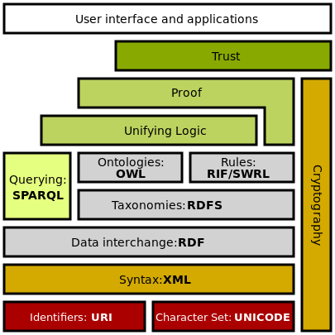
Semantic Web Stack

Slide 8
Understand the RDF data model, including
URI and IRI concepts
Triples
Resources
Literals
Blank Nodes
Lists

Slide 9
RDF = Resource Description Framework
W3C Recommendation since 1998
Version 1.1 since 2014
RDF is a data model
Originally used for metadata for web resources, then generalized
Encodes structured information
Universal, machine readable exchange format
Data structured in graphs
Vertices, edges

Slide 10
Parts of the RDF graph
URIs
Used to reference resources unambiguously
Literals
Describe data values with no clear identity like "100 km/h"
Blank nodes
Facilitate existential quantification for an individual with certain properties without naming it

Slide 11
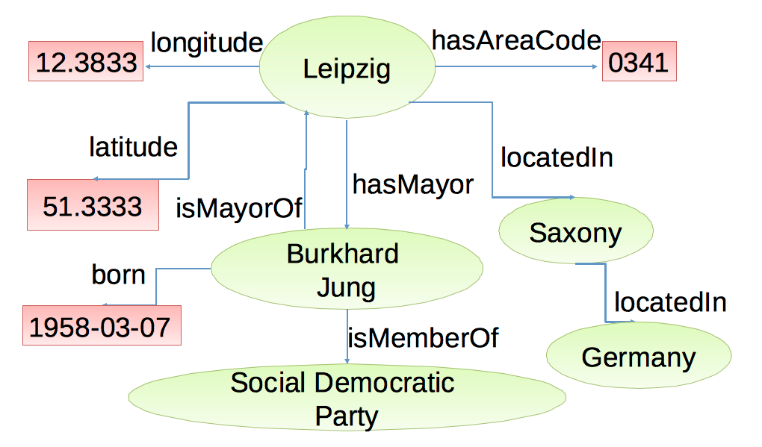
Example of an RDF graph

Slide 12
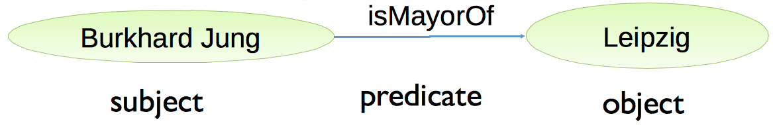
RDF Triple
Components of an RDF triple:
Modeled using linguistic categories (but not always consistent)
Allowed assignments:
Subject: URI or blank node
Predicate: URI (a.k.a. property)
Object: URI, blank node or literal
Node and edge labels should be unambiguous, so that the original graph is reconstructible from triple list

Slide 13
URI
URI = Uniform Resource Identifier
Used to create globally unique names for resources
Every object with a clear identity can be a resource
Books, places, organizations ...
In books domain the ISBN serves the same purpose

Slide 14
URI Syntax
Extension of the URL concept
Not every URI denotes a web document, but the URL is often used as URI for web documents
Starts with URL schema, which is separated from the rest by ":"
examples: http, ftp, mailto, file
Typically hierarchical structure
[scheme:][//authority][path][?query][#fragment]

Slide 15
IRIs
IRI = Internationalized Resource Identifier
Generalization of URI concept
IRI can contain Unicode
Example:
http://www.example.org/Wüste
http://www.example.org/사막

Slide 16
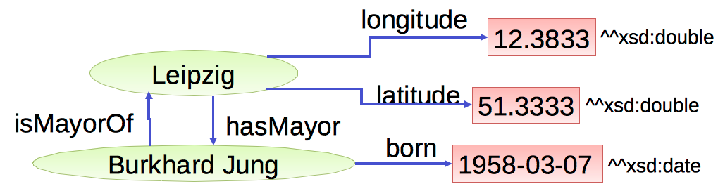
Literals
Used to model data values
Representation as strings
Interpretation through datatype
Literals without datatype are treated as strings
Literals may never be the origin of a node of an RDF graph
Edges may never be labeled with literals

Slide 17
Data Types in RDF
So far: literals are untyped, treated as strings: "02" < "100" < "11" < "2"
Typing allows better, in other words, semantic interpretation of values
Datatypes get identified by URIs and are freely choosable
Typically usage of XML Schema Datatypes (XSD)
Syntax: "data value"^^<datatype-URI>
rdf:HTML and rdf:XMLLiteral are the only predefined datatypes in RDF
Used for HTML and XML fragments

Slide 18
Turtle Syntax
Language to serialize RDF Triples to strings
Turtle – Terse RDF Triple Language
URIs in angle brackets: <http://dbpedia.org/resource/Leipzig>
Literals in quotes
"Leipzig"@de
"51.333332"^^xsd:float
Triples are subject-predicate-object sentences terminated with a dot.
<http://dbpedia.org/resource/Leipzig> <http://www.w3.org/2000/01/rdf-schema#label> "Leipzig"@de .
Whitespace and line breaks are ignored outside of identifiers
Status: W3C Recommendation, http://www.w3.org/TR/turtle/

Slide 19
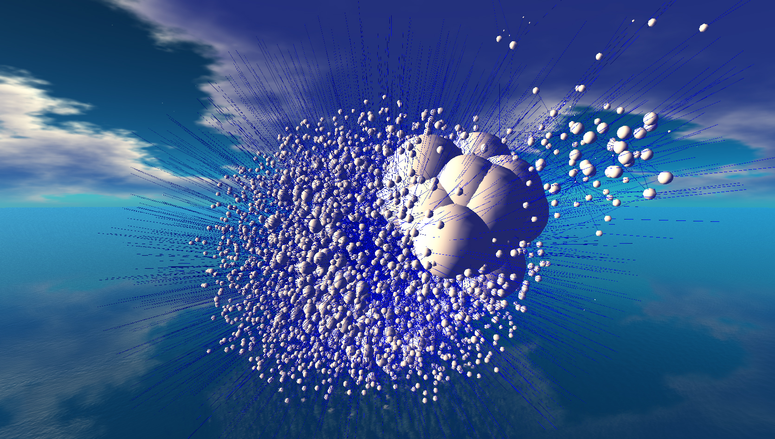
3D Visualization

Slide 20
Exercise 1
Create a small RDF graph in graphical representations and Turtle format
About your family

Slide 21
RDF Serializations
N-Triples
N-Quads
N-QUAD
JASON-LD
RDF/XML
RDF/

